Slide 1

Voice of Customers
Egyptian Foodies

Slide 2
Content
Introduction
Problem Statement & suggested solution
Project overview
Machine learning & NLP
Workflow
Analysis of customers' reviews
Unlocking new insights
Hypothesis test
Conclusion
Future work
Questions?

Slide 3
“Whoever understands the customer best, wins.”
Mike Gospe

Slide 4
Problem Statement
The analysis and understanding of customers' opinions are crucial to improve customer retention and increase revenue. So, the company decided to find out what the customers say about it what they like and what they dislike and whether they support the company or against the company. Next, the marketing team can keep and develop what customers like and change what customers dislike. However, there is a problem. It is costly to hire employees to read and analyze each review so that the company decided to use data science and AI to replace those employees and use new technologies to analyze and understand customers' opinions now or even in the future.

Slide 5
Suggested solution
Using Data Science especially Machine Learning and Natural Language Processing techniques, we can solve this problem by building a classification model that can classify each review then analyze all reviews and extract some useful insights.

Slide 6
Project overview
Voice of Customers
Machine Learning
& NLP
Data Analysis

Slide 7
Machine Learning & NLP
Building a classification model to find the sentiment of each review.
Positive
Negative
Neutral

Slide 8
Workflow
Reviews
Text cleansing
Cleaned reviews
Labeling TextBlob
Labeled reviews
Feature extraction
Tfidf Vectorizer
Feature vectors
Positive
Fitting
Labeled Dataset
Labeling original dataset
Neutral
Random Forest Classifier
Predicted Labels
Negative

Slide 9
Analysis of customers' reviews
Understanding customers` opinion such as what they like, what they dislike
analyzing the sentiment of their reviews whether it is with the company, against the company, or just neutral.

Slide 10
Unlocking some insights

Slide 11
What customers like about our Brand ?

Slide 12
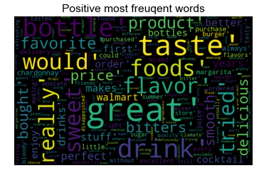

Slide 13
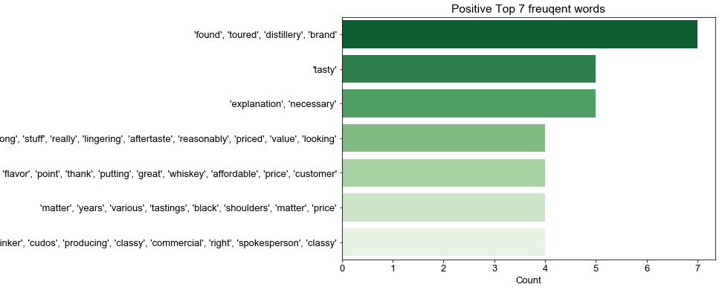

Slide 14
Hypothesis test
There is a huge difference between the sentiment of reviews after purchase and the sentiment of all reviews.

Slide 15
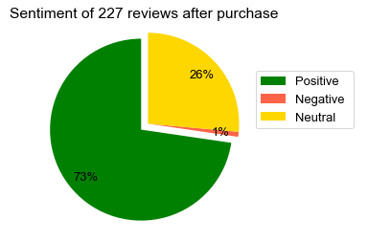
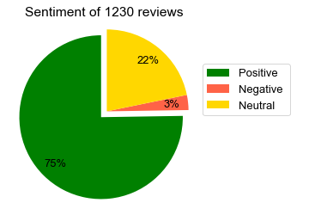

Slide 16
The Hypothesis is rejected

Slide 17
How many customers after purchasing our products gave a rate of 5 Stars?

Slide 18
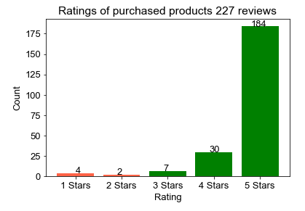

Slide 19
Conclusion

Slide 20
Future work
Applying data science and machine Learning to
Analyze Competitors' activity and their customers' reviews.
Compare between customers' opinion on different social media platforms.

Slide 21
Questions?

